Slide 1

CS184 Project Presentation
Jiajun Li, Qinghang Hong, Yiwei Zhang, Haochen Yang

Slide 2
Woohoo
A quiz game application
Friends answer challenging set of questions together
Players are ranked based on scores in each game
Make friends
Notes:
This app includes quiz games, and a Friend system.
Friends can challenge the same quiz game. Based on the score they get, the system will rank them.
Users also can upload the quiz game if they want. Teachers can ask students to do the same quiz at the same time. Like in lecture, instructors can interact with students online.

Slide 3
Why we build this app?
I-Clicker is not useful during zoom classes
An online quiz keeps students engaged
People need some fun
Play with friends in leisure time
Notes:
Before the pandemic, instructors use a device like an i-clicker to monitor students’ participation. During the pandemic, it is hard to get students’ attention and keep students active in class. With the live quiz systems, teachers can easily host a live quiz for their students and record the results. It is also a great leisure entertainment for people who want to socialize with their friends, to answer some general purpose questions, and compete with each other.

Slide 4
Similar Existing apps and website
Kahoot!
A free game-based learning platform
Developed in multiply platform
Zoom
Hosts can only choose polls created by themselves

Slide 5
Main functionalities
Users can answer quizzes concurrently by sharing room code.
Users can upload customized questions.
Friend System

Slide 6
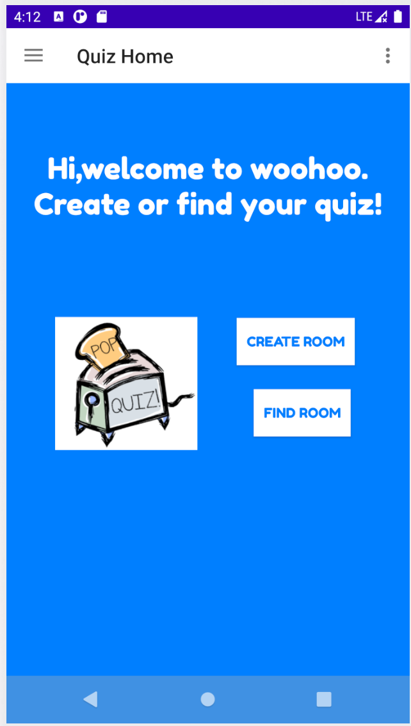
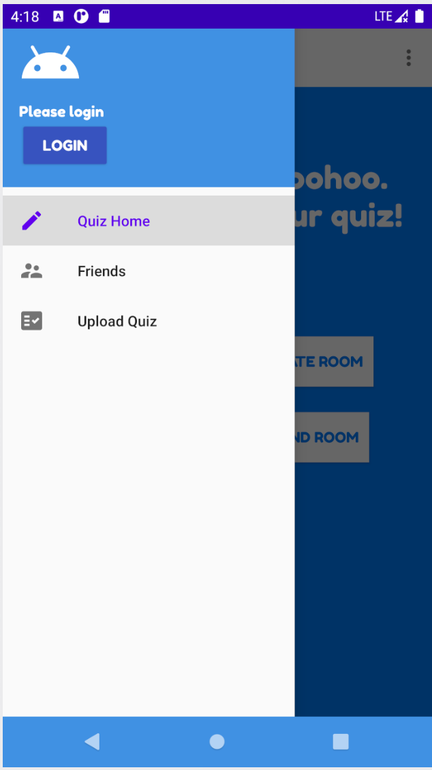
Main Activity

Slide 7
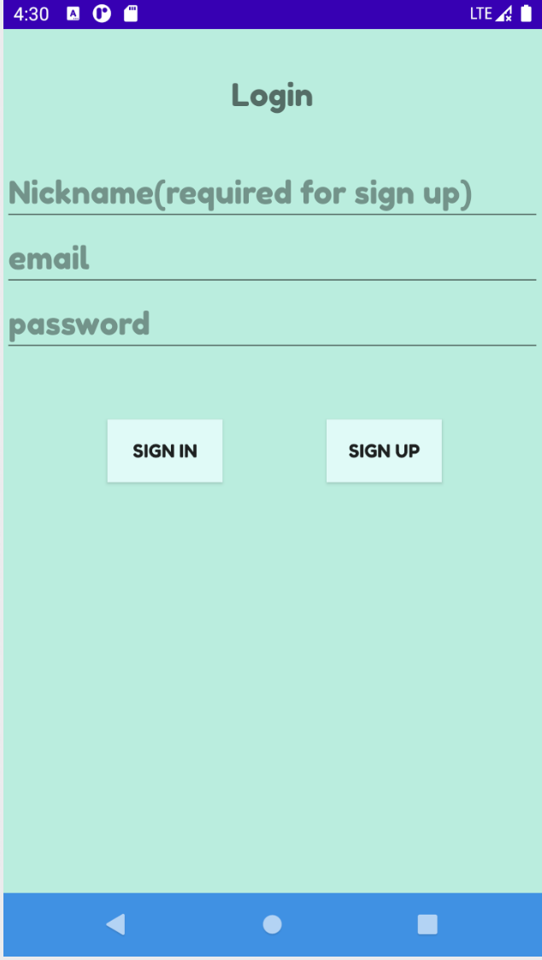
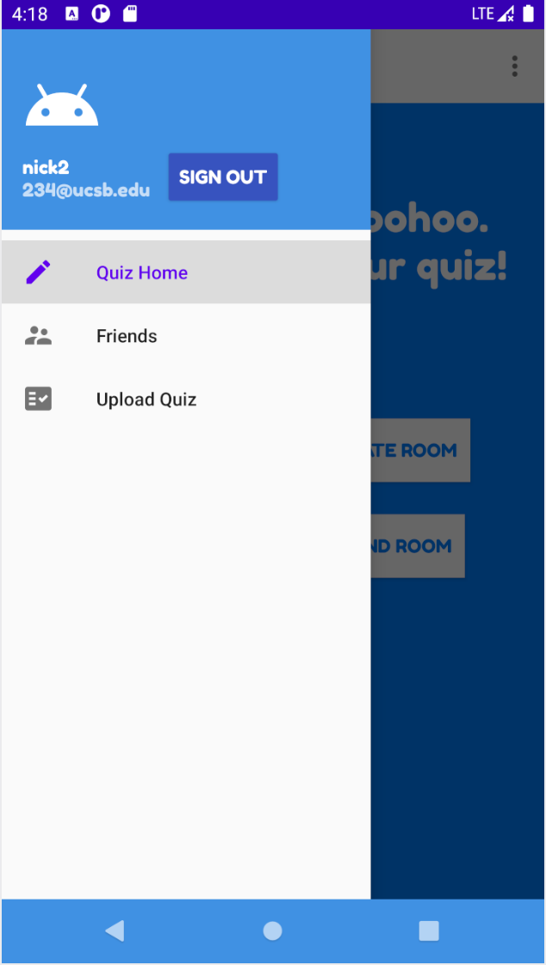
Login

Slide 8
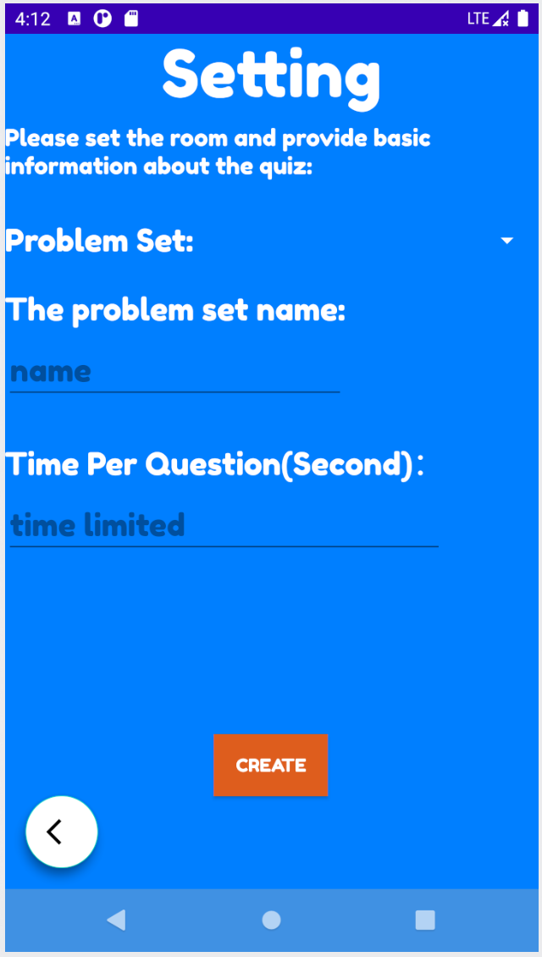
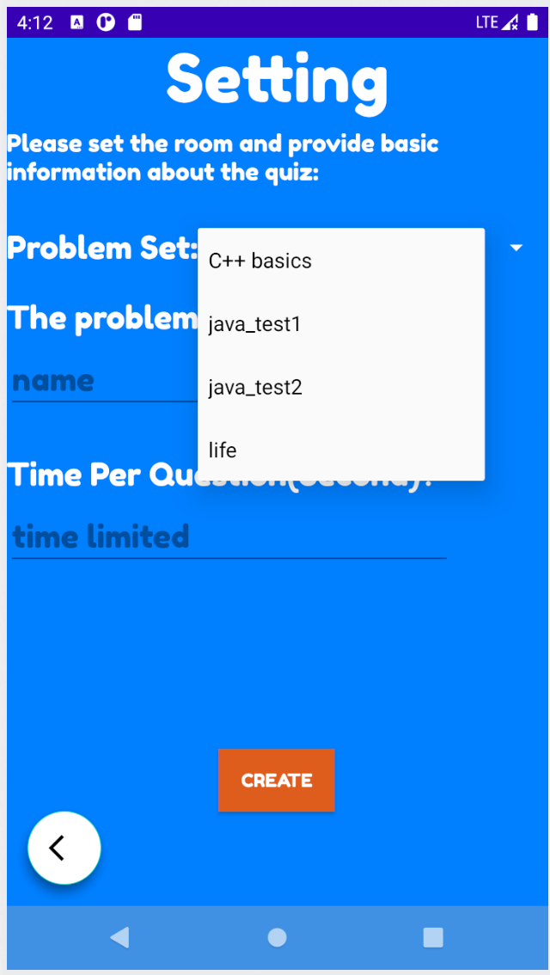
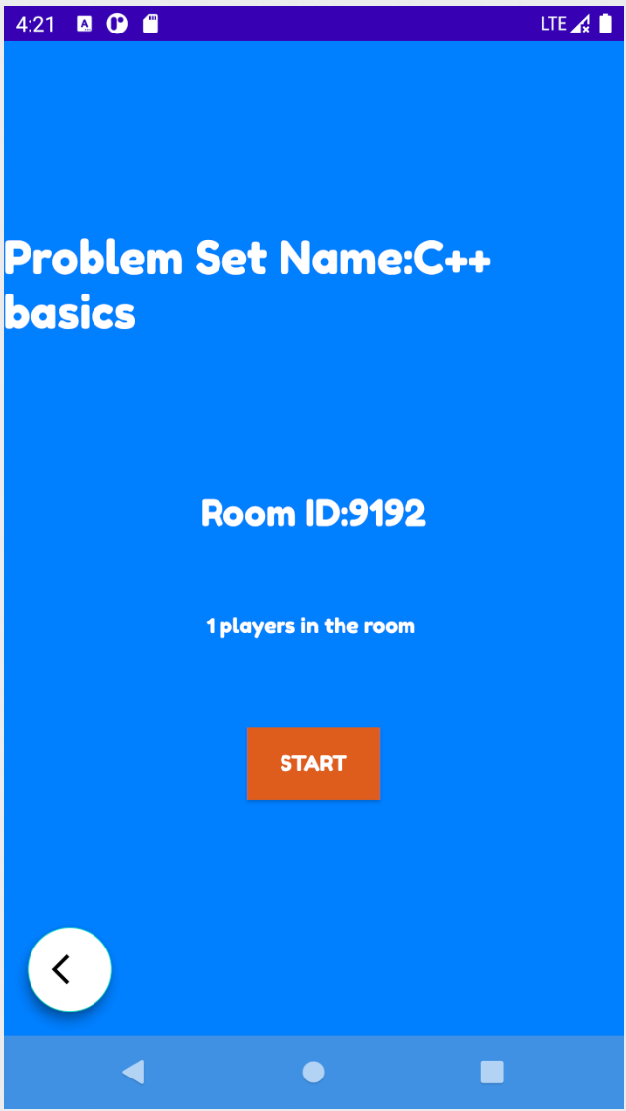
Quiz - Create Room
Notes:
Create Room introduction

Slide 9
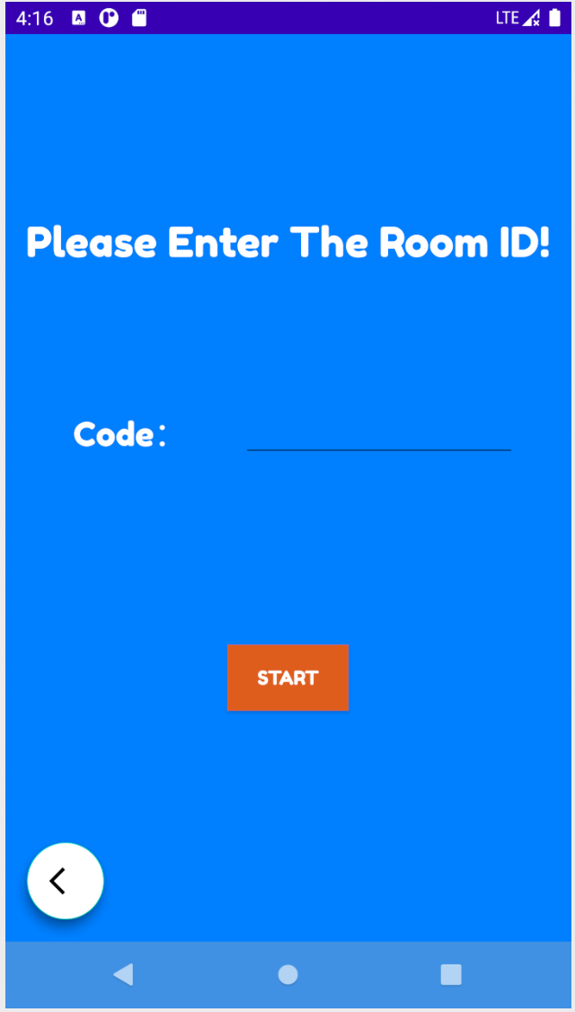
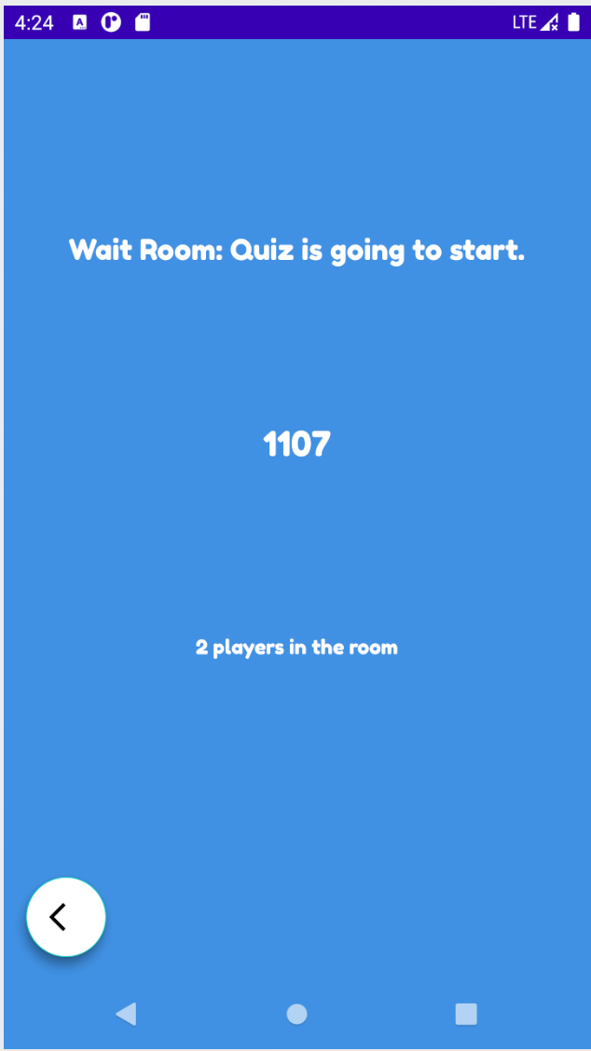
Quiz - Find Room

Slide 10
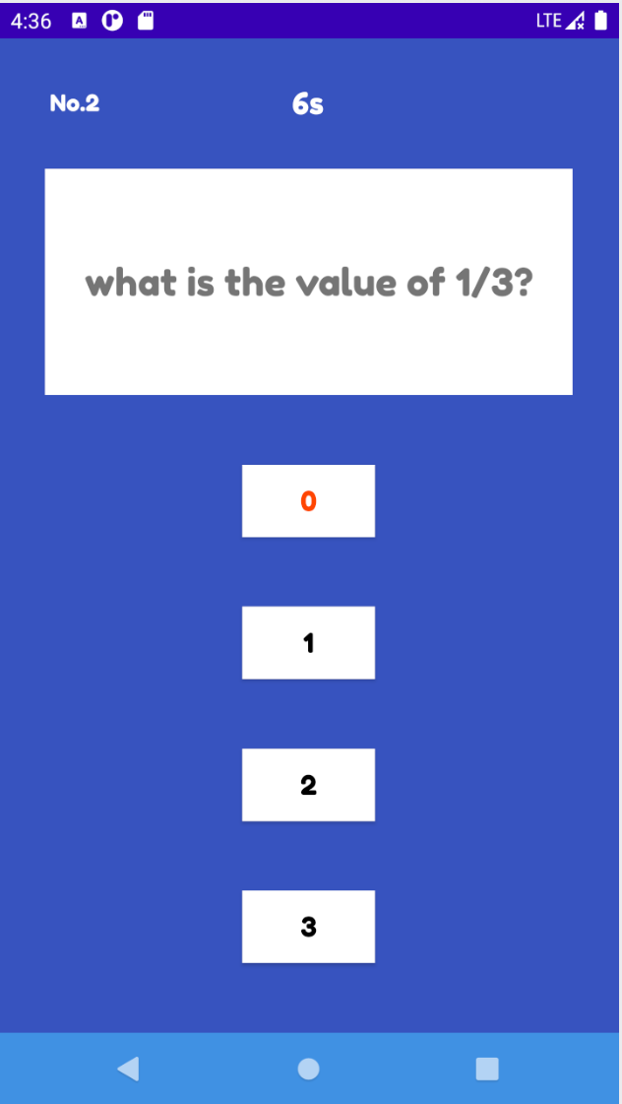
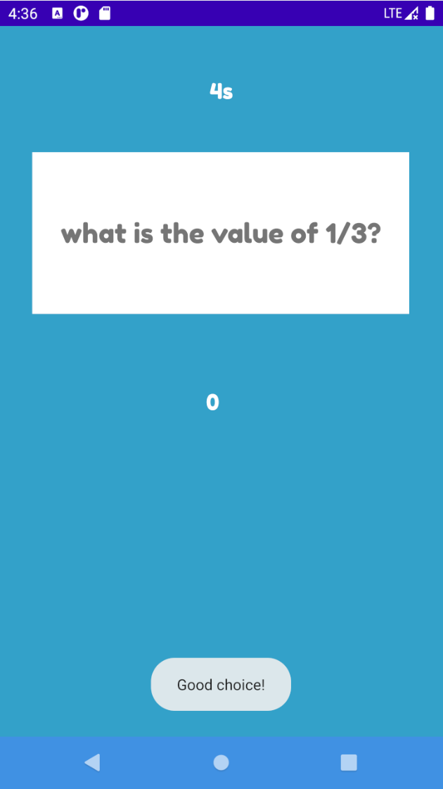
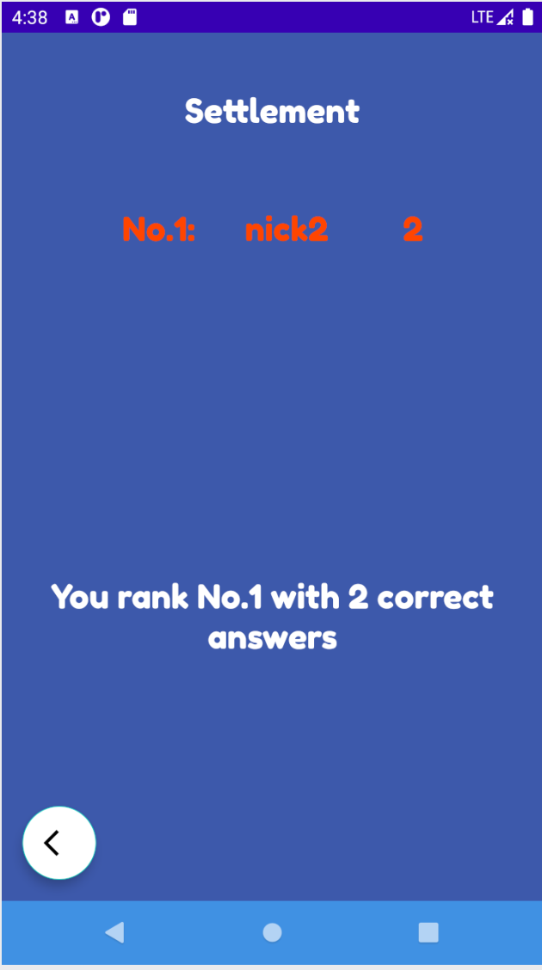
Quiz - Answer Questions and Rank

Slide 11
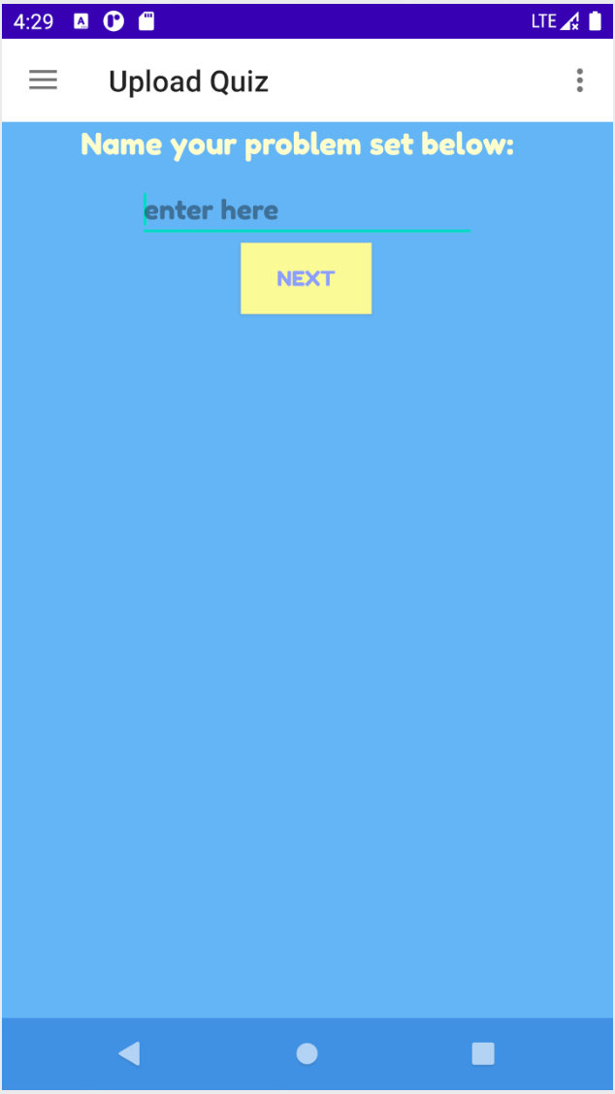
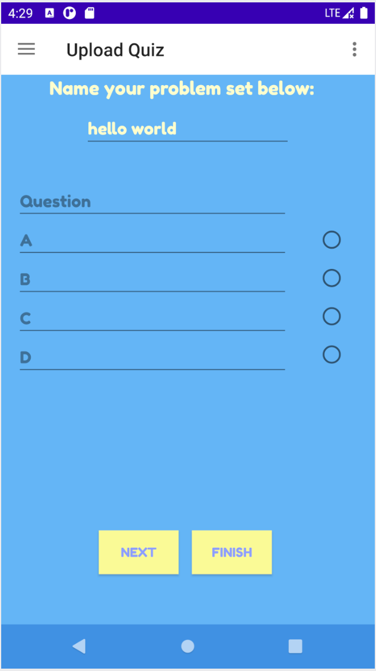
Upload Customized Questions

Slide 12
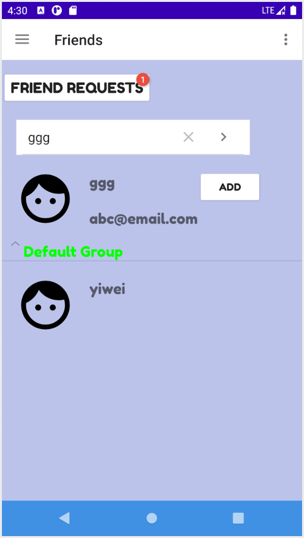
Friend System

Slide 13
It’s Show Time !

Slide 14
Implementation Difficulties
Cannot pull information on time
Read questions & Rank all players
Notes:
Implementation Difficulties
Problems
Reading questions from firebase before starting quiz
Render the page before the firebase operation is completed
Ranking all the players until all finish
Not all players finish at the same time, so data in firebase is not up-to-date
Solution
Create a new thread and use handler
Create a dialogue window
Wait for firebase operations are completed before rendering the page

Slide 15
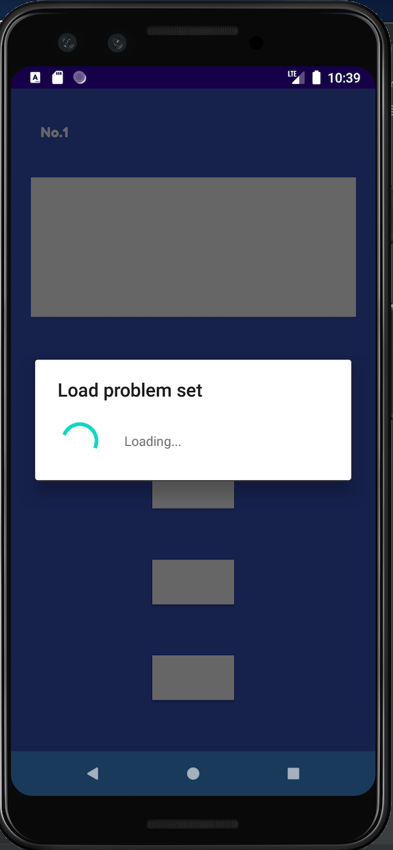
Implementation Difficulties
Solution
Create a new thread and use handler
Create a dialogue window

Slide 16
Future Improvement
UI Design Improvement
Add animation
Create group game
Allow group competition (3v3)
Send game invitation to friend
One click to join the game
Notes:
1.Add some animations when one user interacts with the application
2.Allow groups of people to play against each other groups (e.g., 3vs3).
3.One user can invite friends to do a quiz(against the user or with the user).

Slide 17
Question Time

Slide 18
Thank you!

